Slide 1
INFORMATION THEORY
Project
IITU, ALMATY, 2019
Notes:
IITU, Almaty, Fall 2012
SEPTEMBER 5, 2012
By Assem Zhamankulova, MSCS

Slide 2
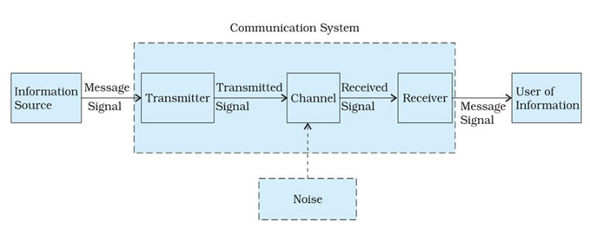
Communication system

Slide 3
Communication system
Noise
Noise refers to the unwanted signals that tend to disturb the transmission and processing of message signals in a communication system. The source generating the noise may be located inside or outside the system.
Transmitter
A transmitter processes the incoming message signal so as to make it suitable for transmission through a channel and subsequent reception
Receiver
A receiver extracts the desired message signals from the received signals at the channel output.

Slide 4
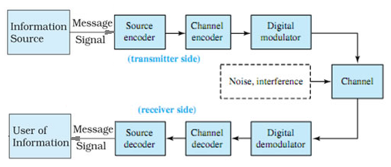
Communication system

Slide 5
Project Plan
Groups: 3-4 students
7 weeks – 6 parts & defense (with report)

Slide 6
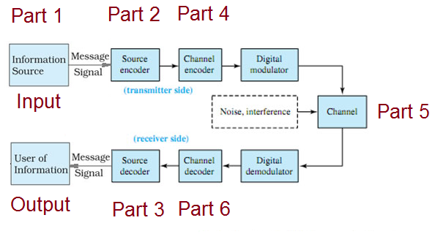
Project structure

Slide 7
Part 1
Input: “Text.txt” file (English text).
Goal: C++ (or another) program finds all symbols (not only letters) in this text and computes their probabilities.
Outpit: list of all unique symbols from the text with their probabilities.
Example:
A – 0,014
B – 0,012
…

Slide 8
Part 2
Input: “Text.txt” file and the result from Part 1.
Goal: Encode the text from the “Text.txt” file using Shannon-Fano or Huffman algorithm with probabilities from Part 1.
Output: a sequence of binary digits.
Example:
101101011…

Slide 9
Part 3
Input: a sequence of binary digits from Part 2.
Goal: Decode back into text the result binary sequence after Part2 (Shannon-Fano or Huffman code).
Output: a text identical to an initial text from “Text.txt” file.

Slide 10
Part 4
Input: a sequence of binary digits from Part 2.
Goal: Encode the result binary sequence after Part2 (Shannon-Fano or Huffman code) with Hamming code.
Output: a sequence of binary digits ready for error-correction.

Slide 11
Part 5
Input: a sequence of binary digits from Part 4.
Goal: Add errors to the result binary sequence after Part4 (Hamming code) with a certain interval.
Output: a sequence of binary digits after Hamming code with artificially created errors.

Slide 12
Part 6
Input: a sequence of binary digits from Part 5.
Goal: Decode Hamming code and fix errors.
Output: a sequence of binary digits identical to an output sequence from Part 2.

